Slide 1
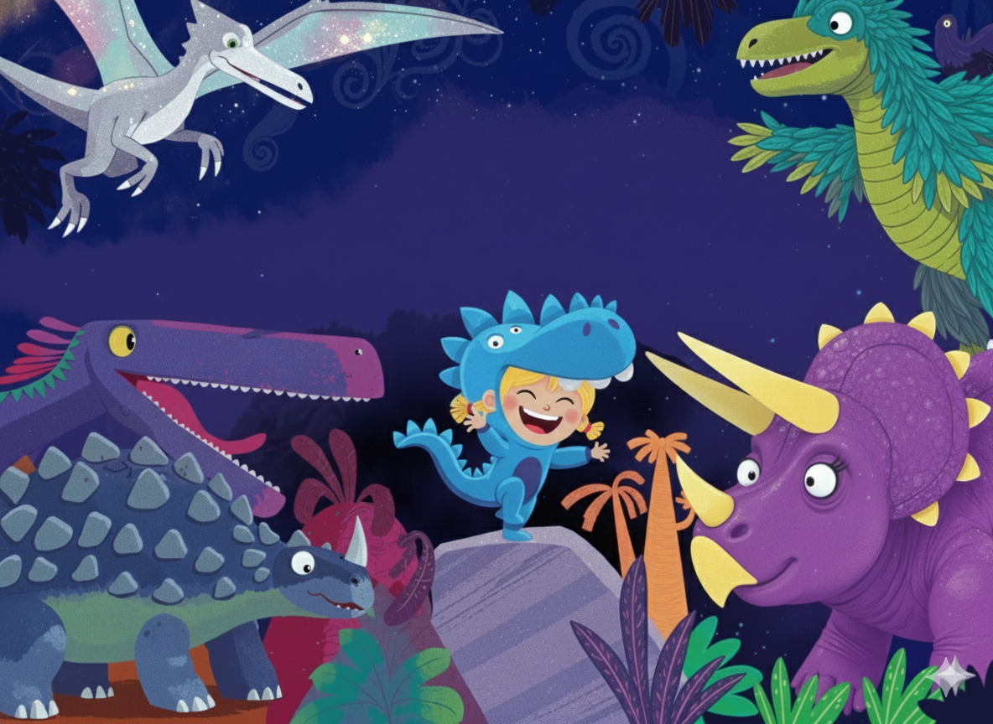
I’M A
{{CHILD_NAME_UPPER}}-O-SAURUS

Slide 2
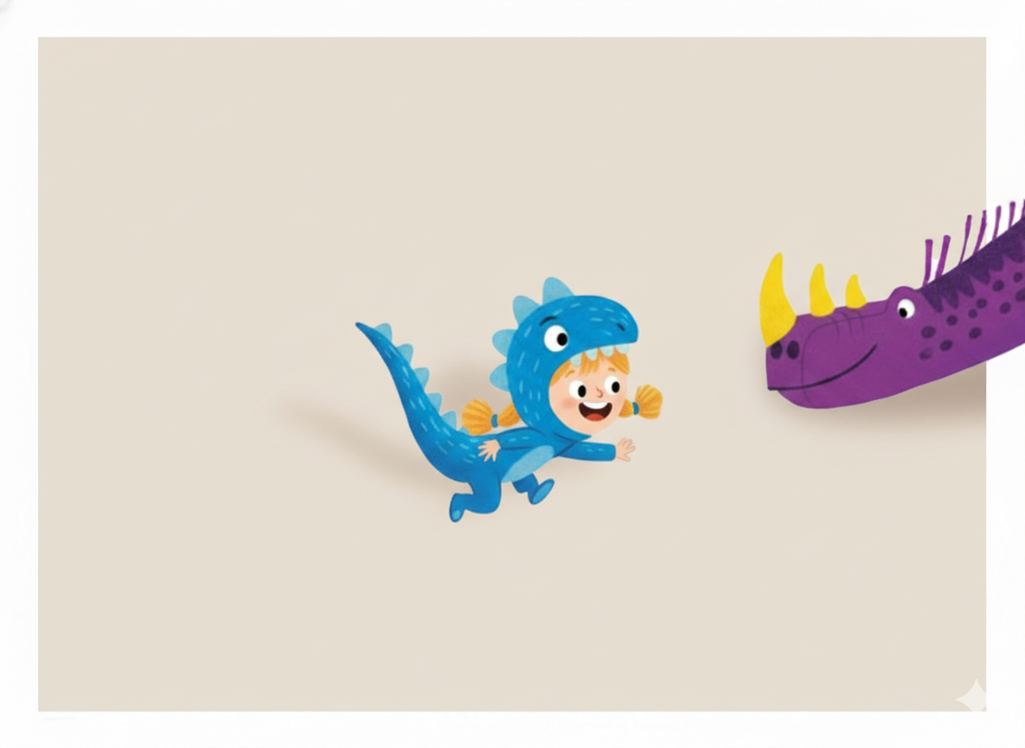
{{CHILD_NAME}},
Welcome to your one-of-a-kind
Wonderbly book !
Written by Clara Adams Illustrated by Flora Bennett

Slide 3
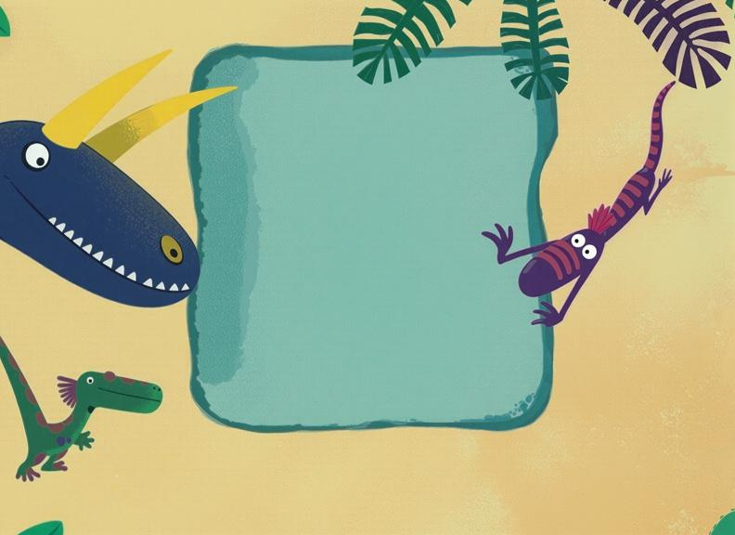
Made with love at kiddie-corner.com
Design by Luffy Production by SC Media House

Slide 4
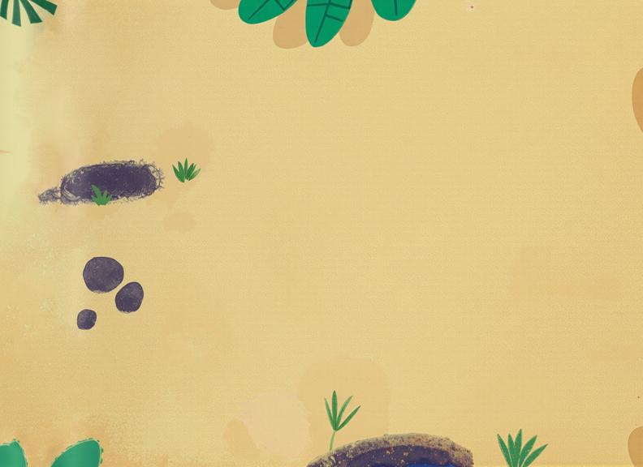
Dear {{CHILD_NAME}},
We hope your days are as full of clomping, stomping. romping adventures as this book is. Have a delightful time in Dino Land!

Slide 5
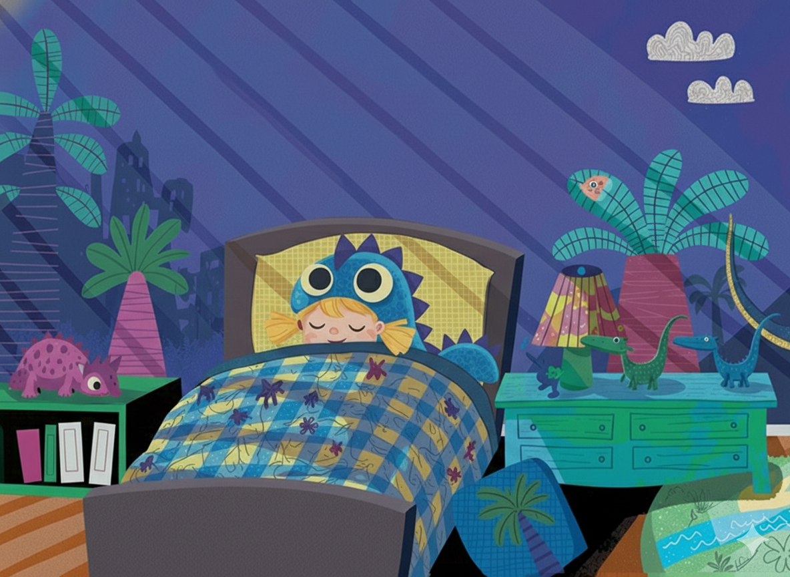
{{CHILD_NAME}} has a dream - she'd love nothing more Than to be turned into a huge DINOSAUR!
Covered in scales, with great teeth and claws, She'd let out the fiercest, scariest roars!

Slide 6
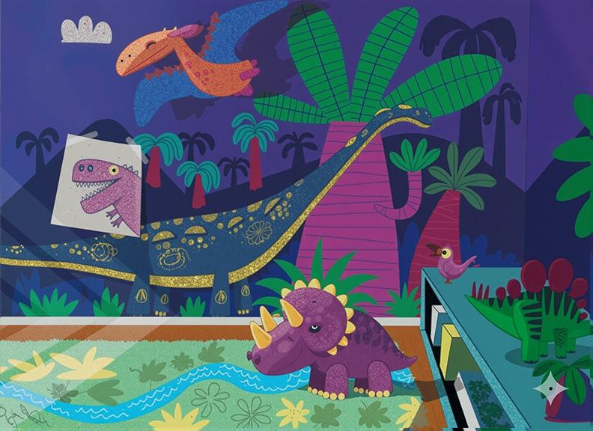

Slide 7
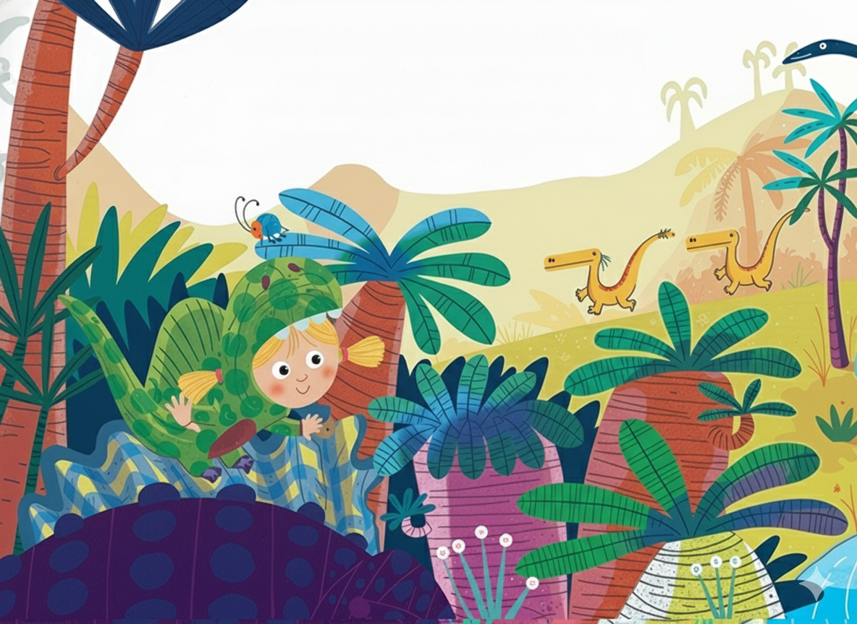
What's this? A noise wakes her up in the night.
She looks all around, and hears with delight A monstrous, hair-raising hullabaloo...
She's in Dino Land - her dream has come true!

Slide 8
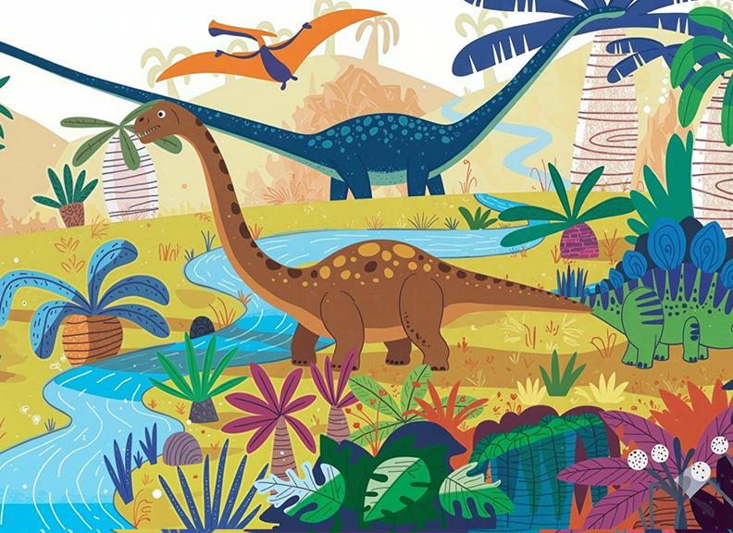

Slide 9
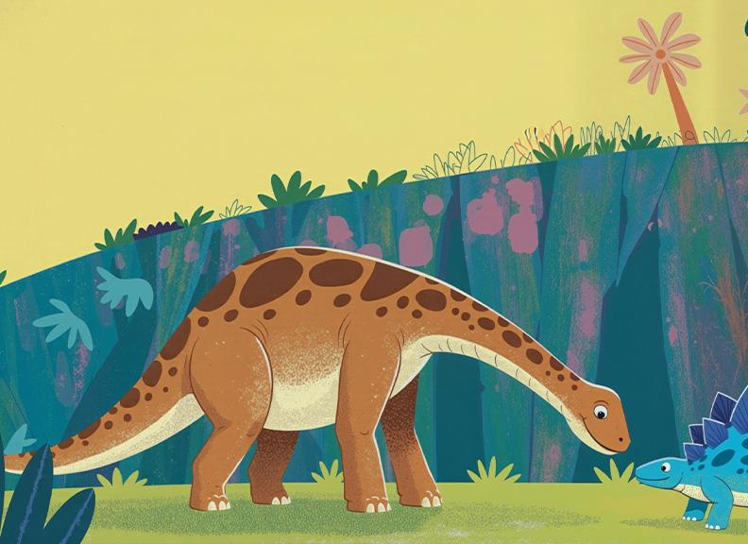
Look over there! What strange looking things, With sharp pointy heads and humongous wings!
They all turn around and squawk, "How do you do?
We're Pterodactyls. Whatever are you?"

Slide 10
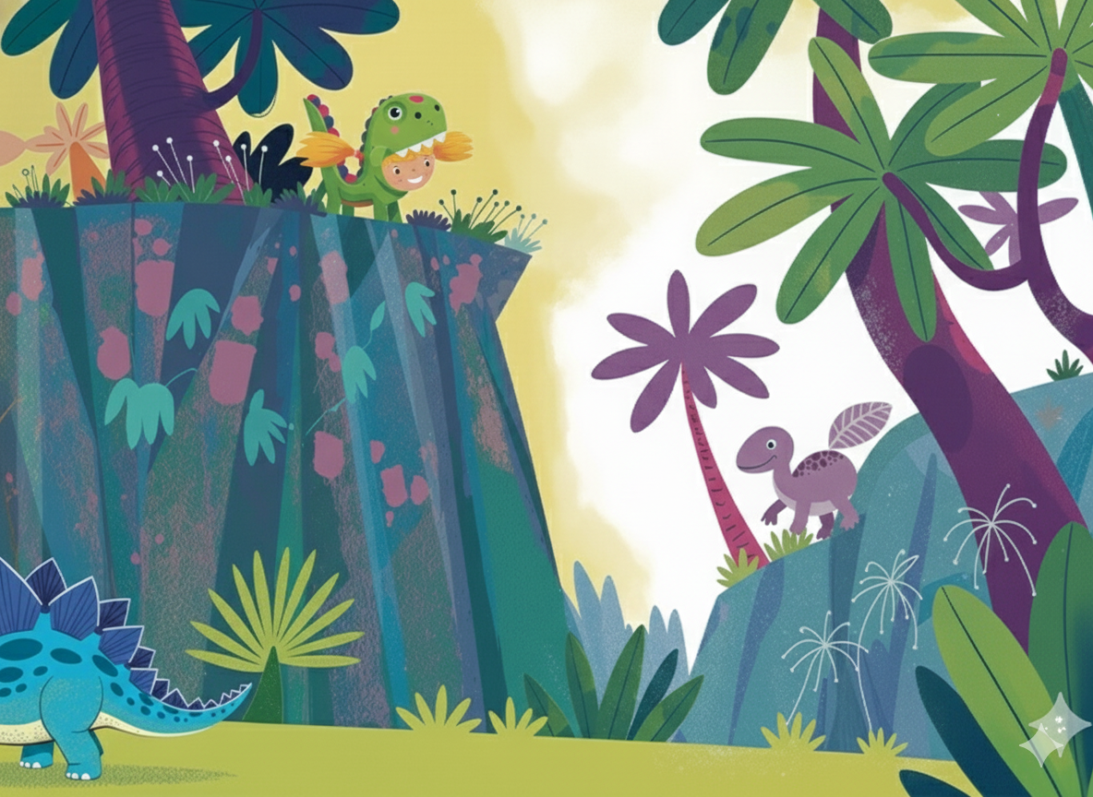

Slide 11
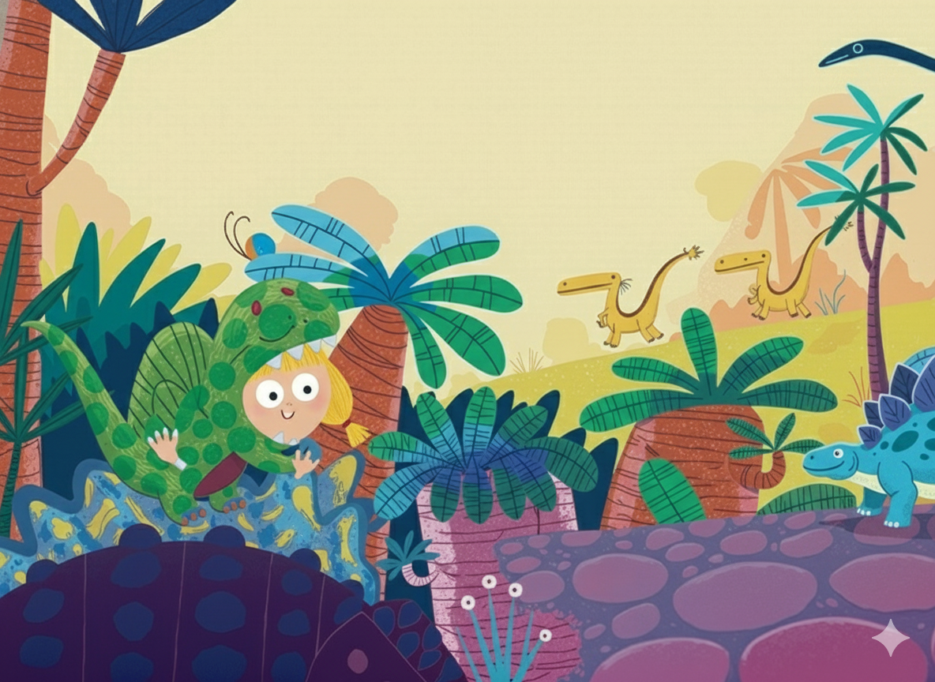
“I’M A

Slide 12
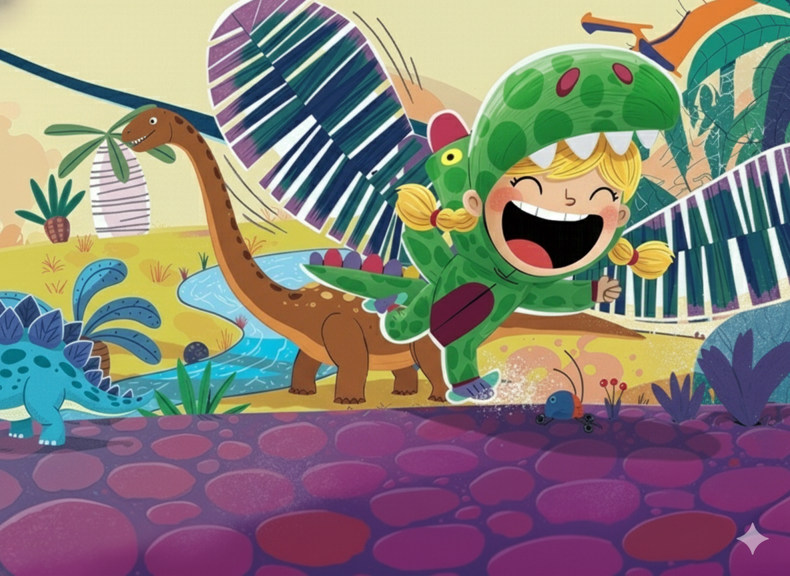
{{CHILD_NAME}}-o-dactyl!”

Slide 13
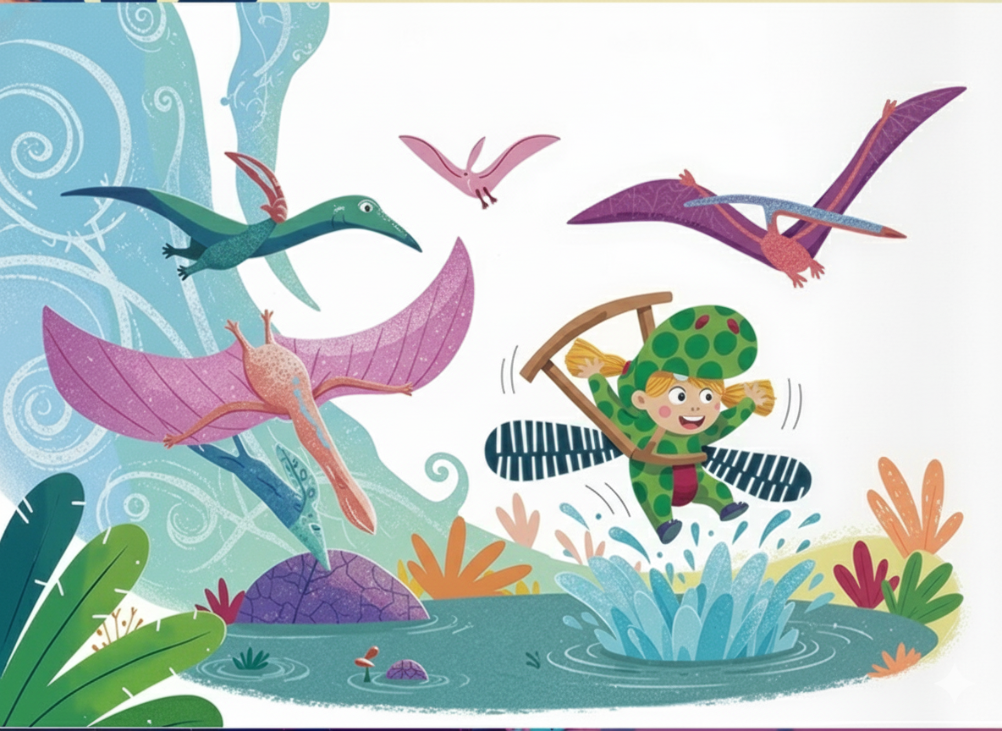
She tried the flap, she tried the soar, but gravity had her by at the core!

Slide 14
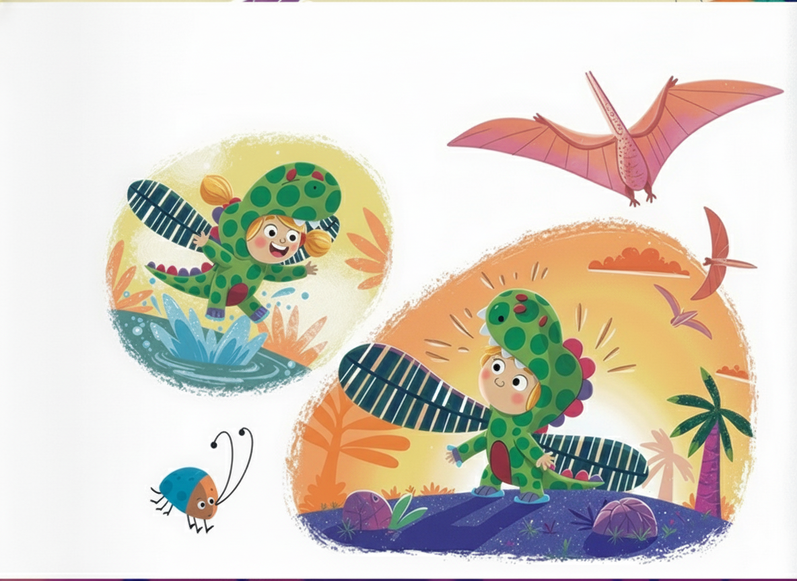
Instead of flight, she found the plop right in the middle, ker-flop!

Slide 15
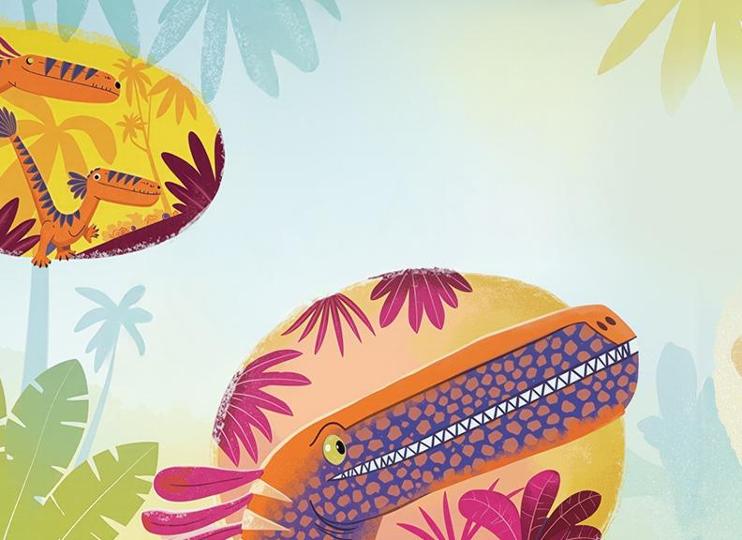
Look over there! What a fearsome bunch, With legs that can run, and jaws that can crunch.
They scurry across and grin, "How do you do?
We're Velociraptors. Whatever are you?"
“I’M A {{CHILD_NAME}}

Slide 16
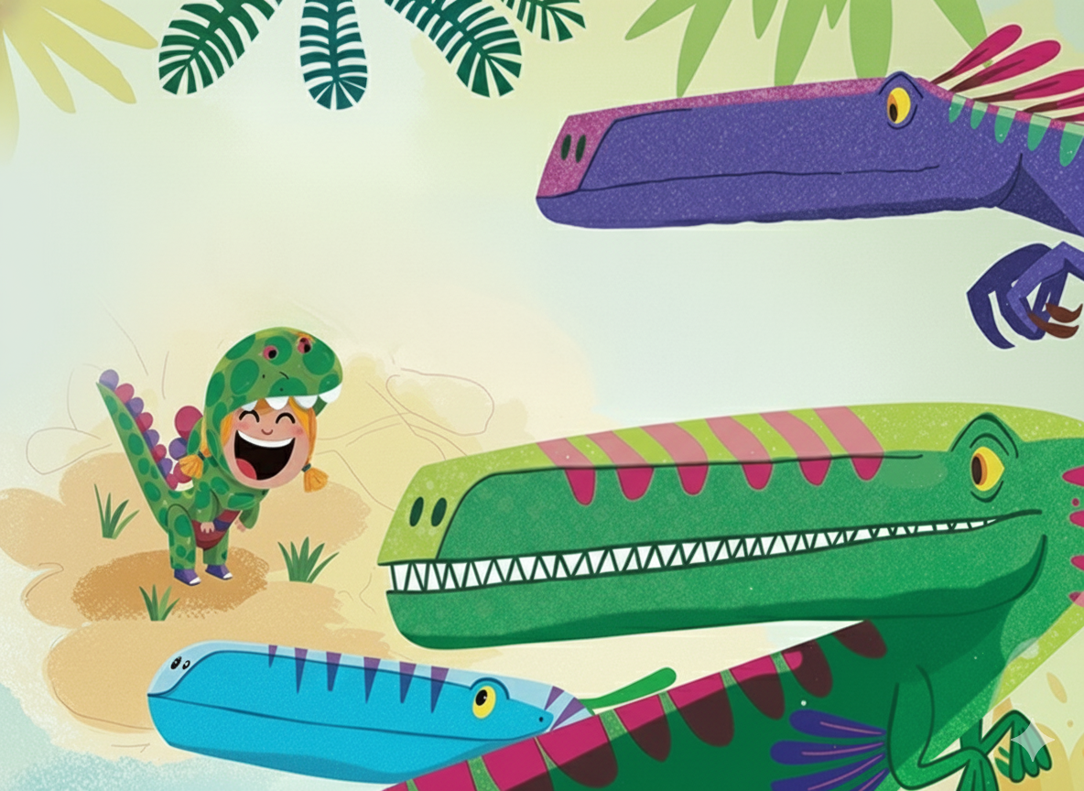
-I-RAPTOR

Slide 17
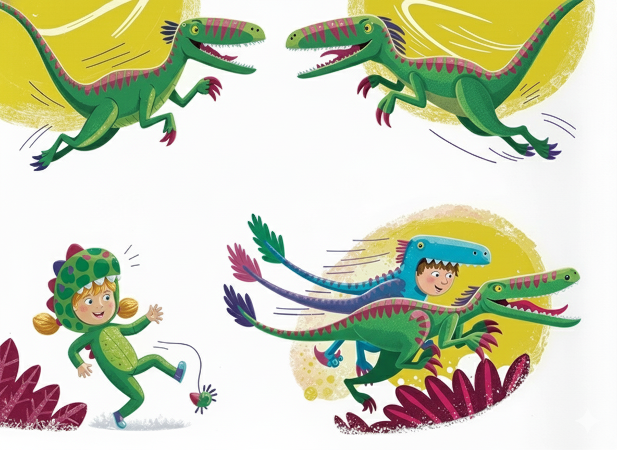
Together they bound and they dart and they dash, They race through the forest as quick as a flash.

Slide 18
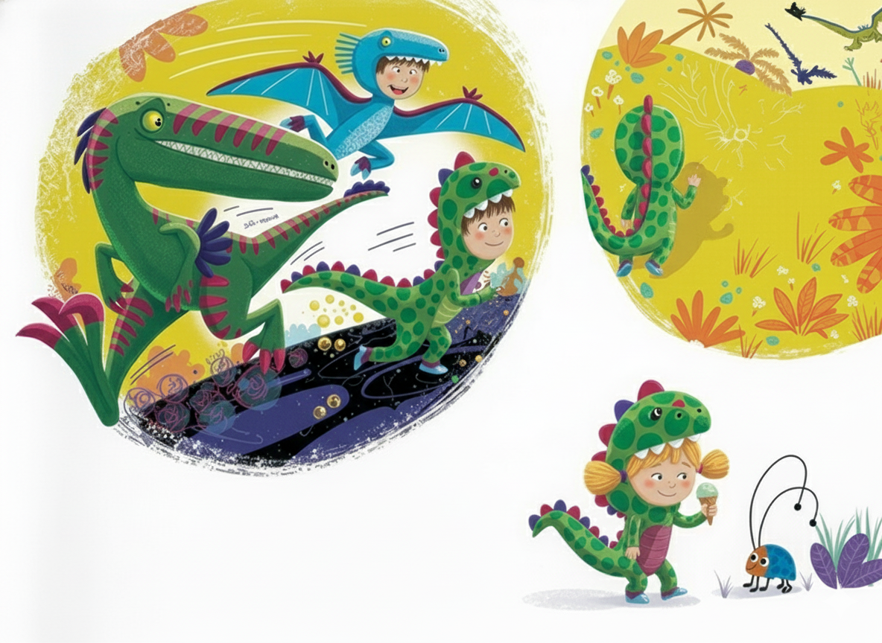
{{CHILD_NAME}} tries to keep up with all of her might . ..
But soon they have zoomed away, clean out of sight!

Slide 19
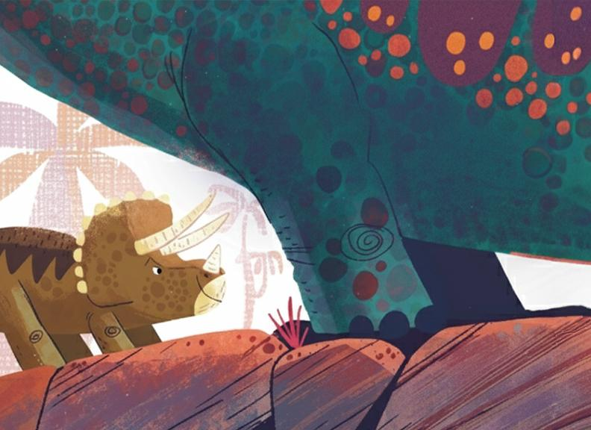
Look over there! What creatures are those?
With two horns on their head, and one on their nose.
They bend their huge necks and snort, "How do you do?
We're Triceratops. Whatever are you?"
"I'M A TRI

Slide 20
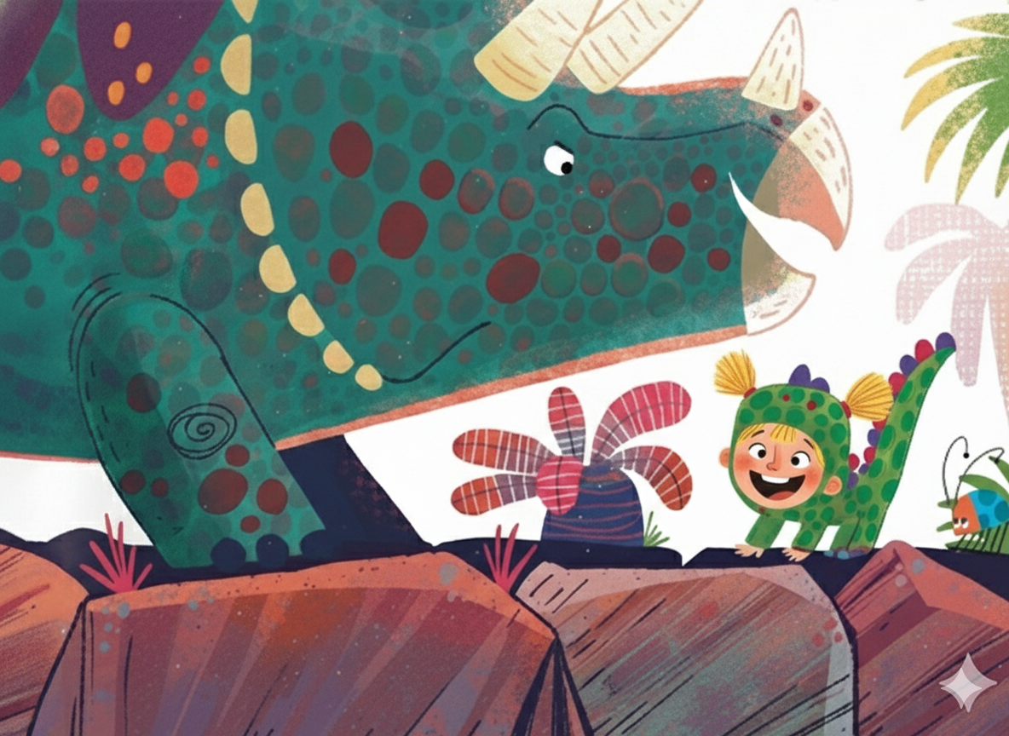
-{{CHILD_NAME}}-ATOPS!"

Slide 21
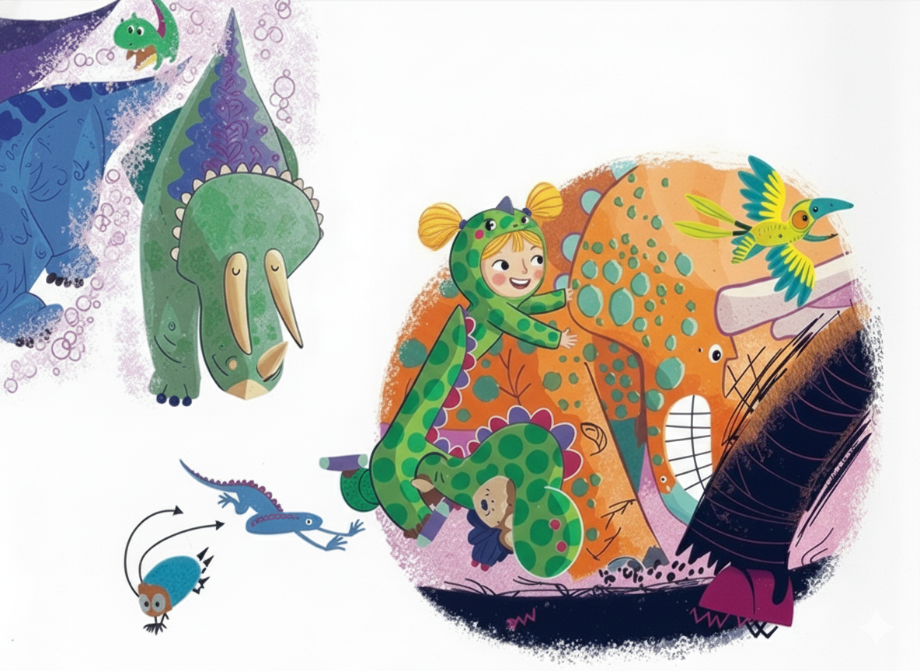
Together they trample and stampede and smash, They Clatter and Shatter and batter and bash.

Slide 22
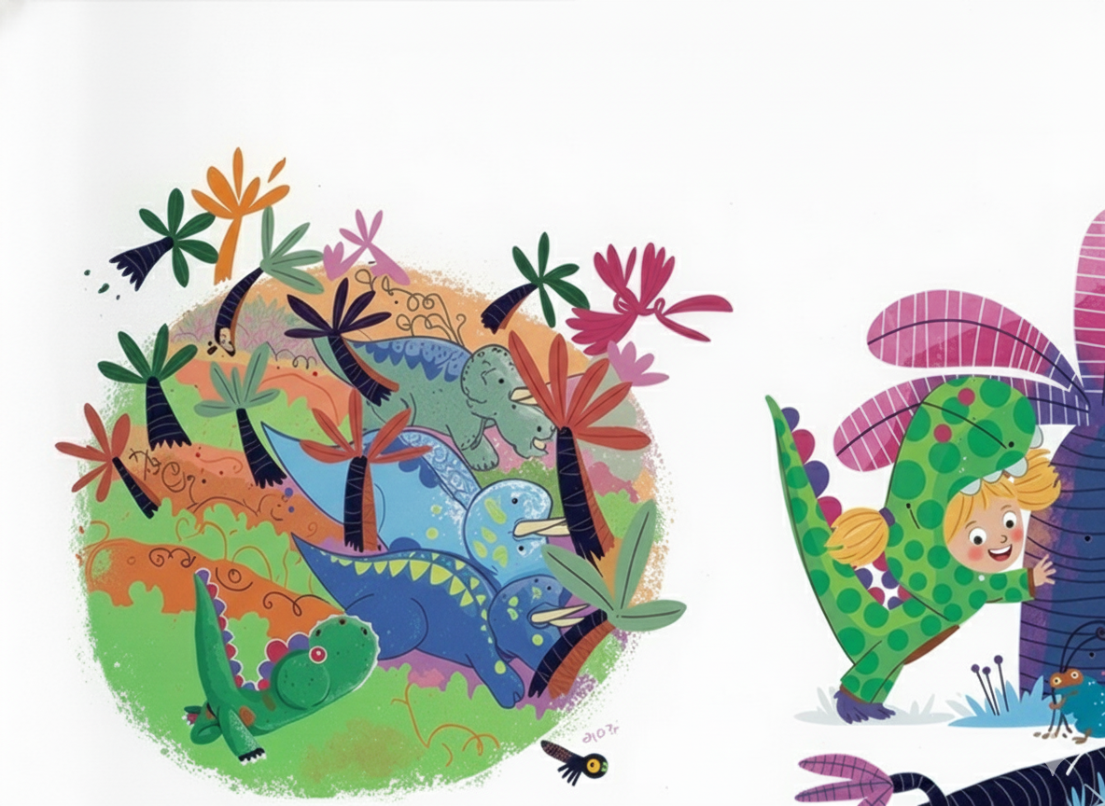
They Charge through the forest with frightening ease..
But {{CHILD_NAME}} soon discovers she can't knock down trees!

Slide 23
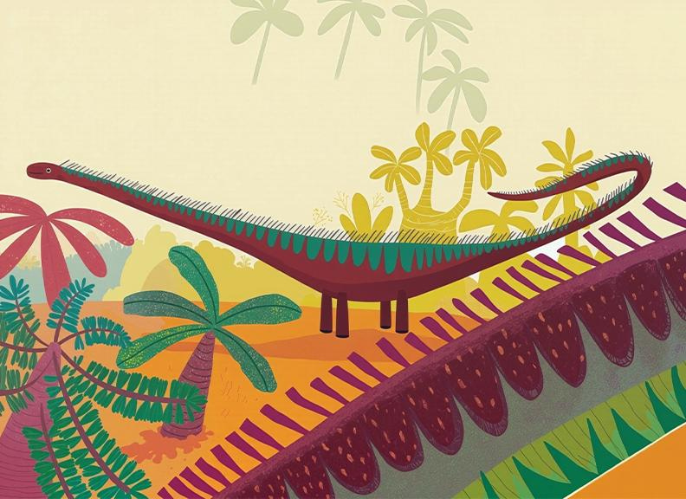
I’M A Mo
Look over there! Now what does she spy?
With sky-scraping necks, eating leaves way up high.
They stoop down and yawn to her, "How do you do?
We're Diplodocuses. What are you?"

Slide 24
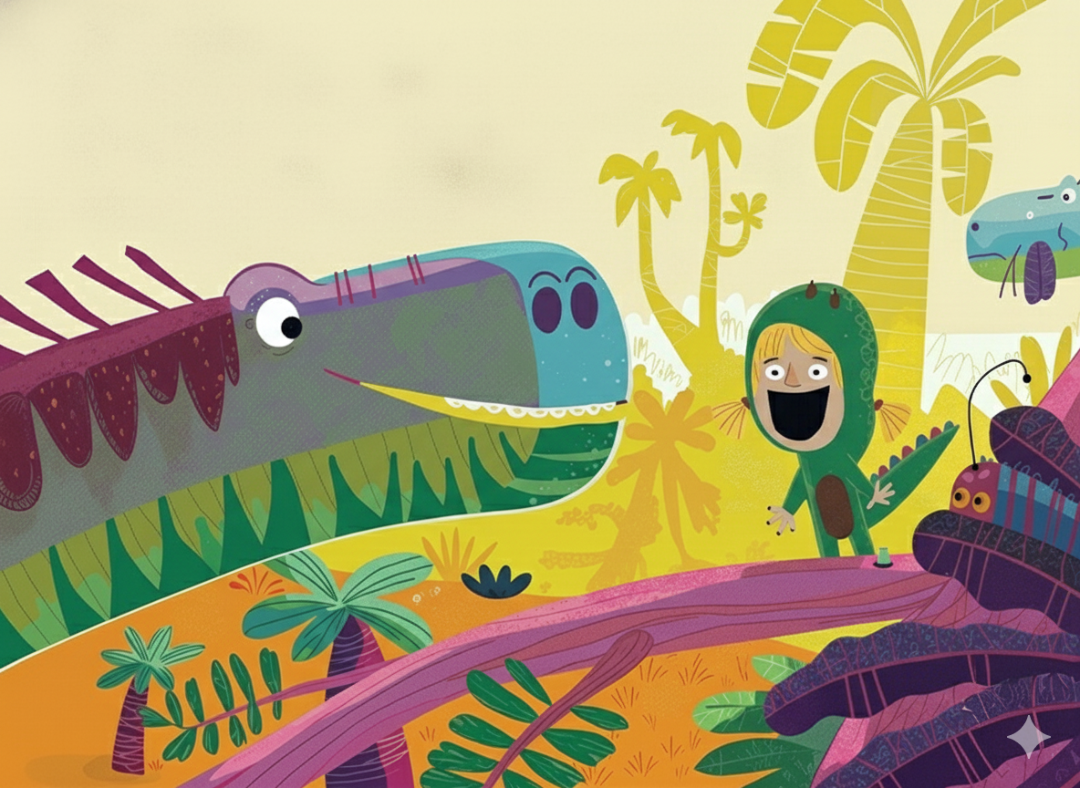
{{CHILD_NAME}}-O-DOCUS!"

Slide 25
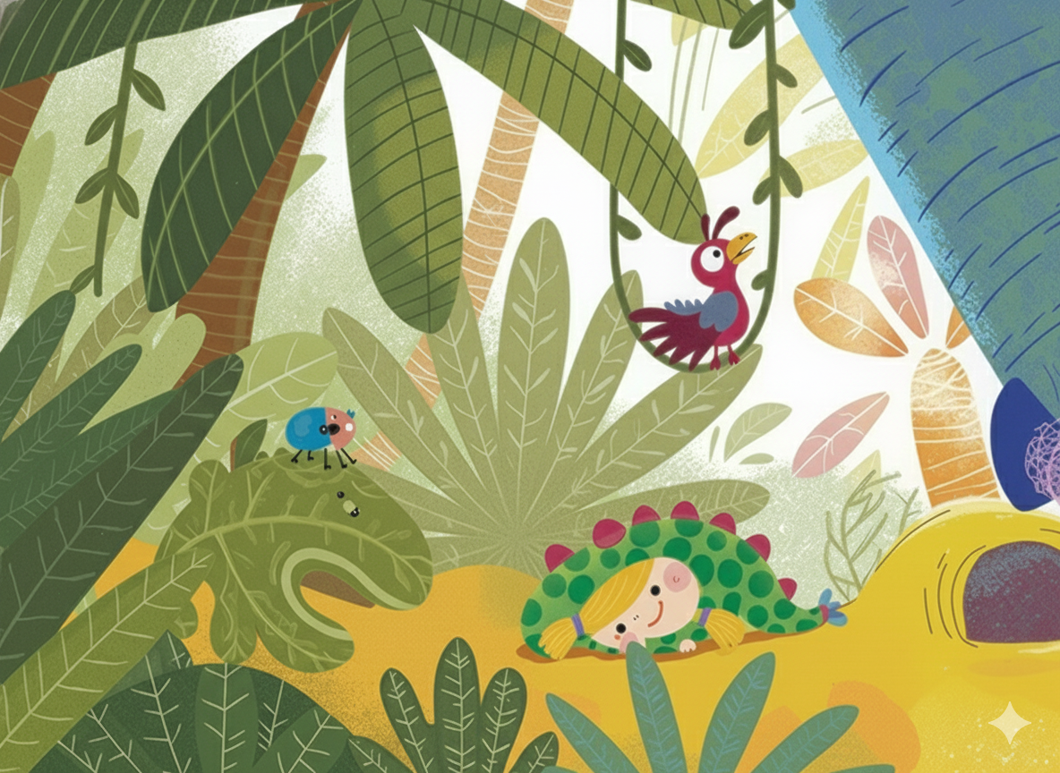
Together they thump and they pound and they comp,
They Squish and they Squash and they stamp and they stomp.

Slide 26
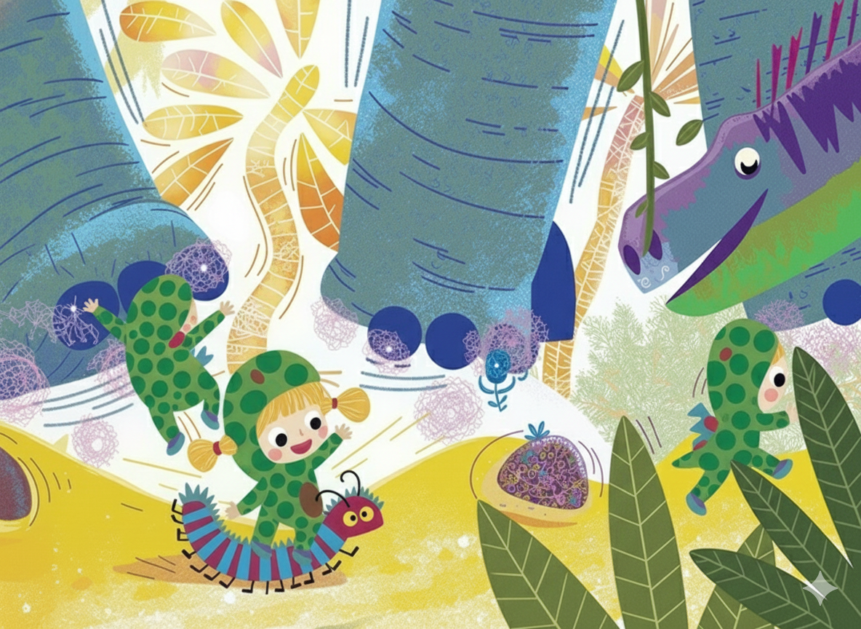
They soon make the whole forest quiver and quake .. but {{CHILD_NAME}} is too little to make the earth shake

Slide 27
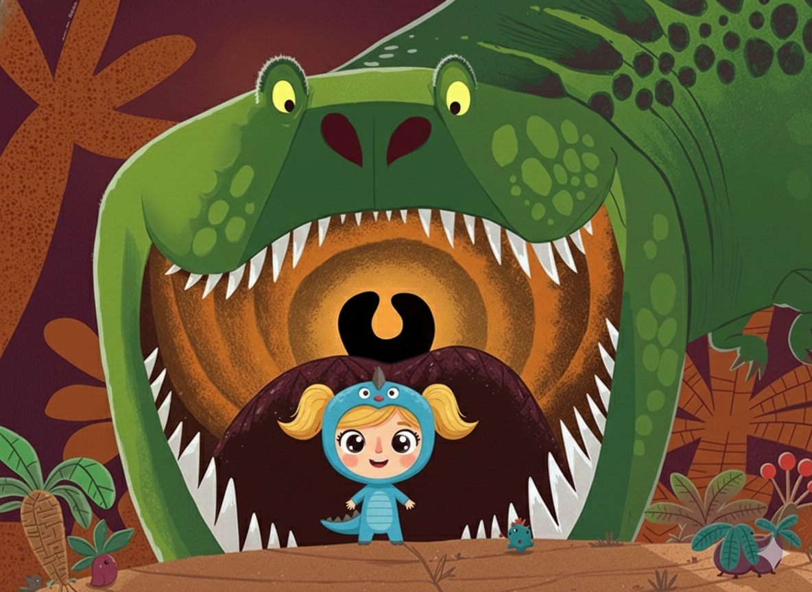

Slide 28
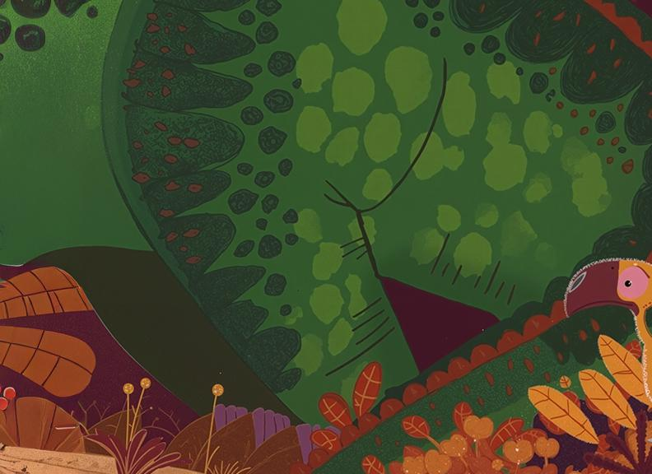
Look over there! What a terrible sight, With claws that can tear, and teeth that can bite. it looks down at {{CHILD_NAME}} and roars,
"How do you do?
I'm Tyrannosaurus Rex. What are you?"

Slide 29
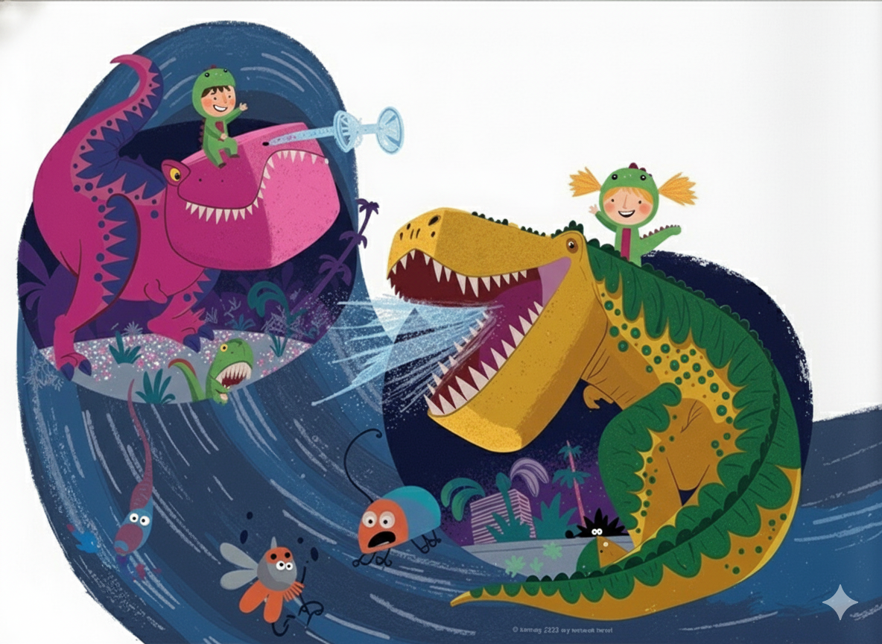
Together they rumble and bellow and growl, They grumble and thunder and holler and howl.

Slide 30
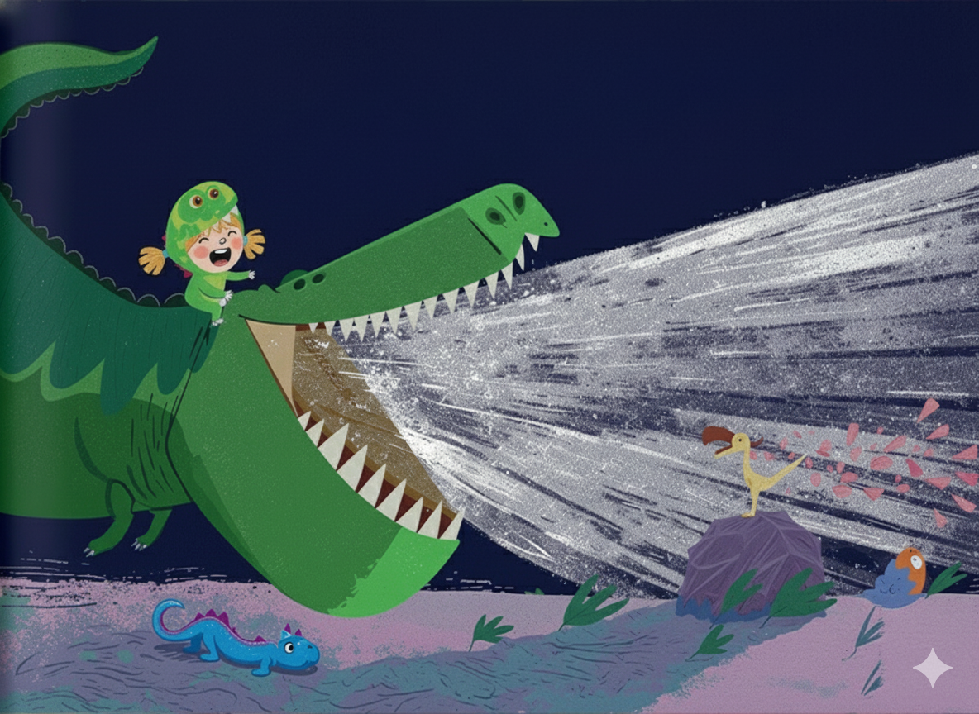
{{CHILD_NAME}} lets out a huge, ear-splitting roar...
Then her throat is so sore she can't roar any more!

Slide 31
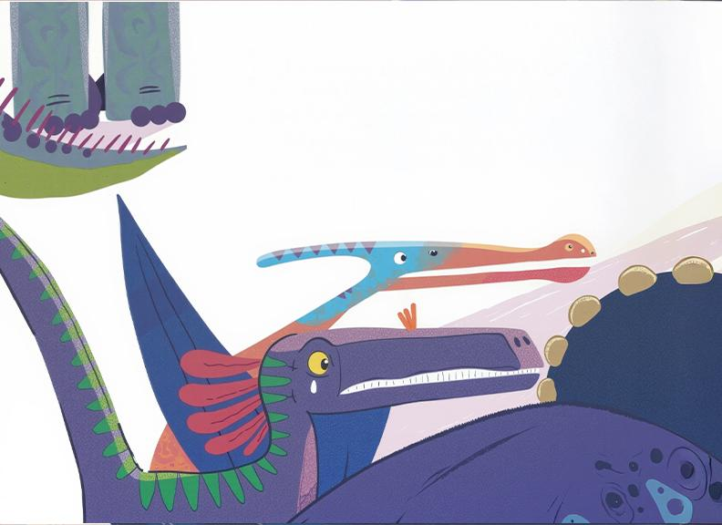
"I'm just not a dino," {{CHILD_NAME}} says with a sigh.
"I can bash but not smash, I can flap but not fly.
I can dart but not zoom, I can Stomp but not squish ..
Yet being a dino is my biggest wish!"

Slide 32
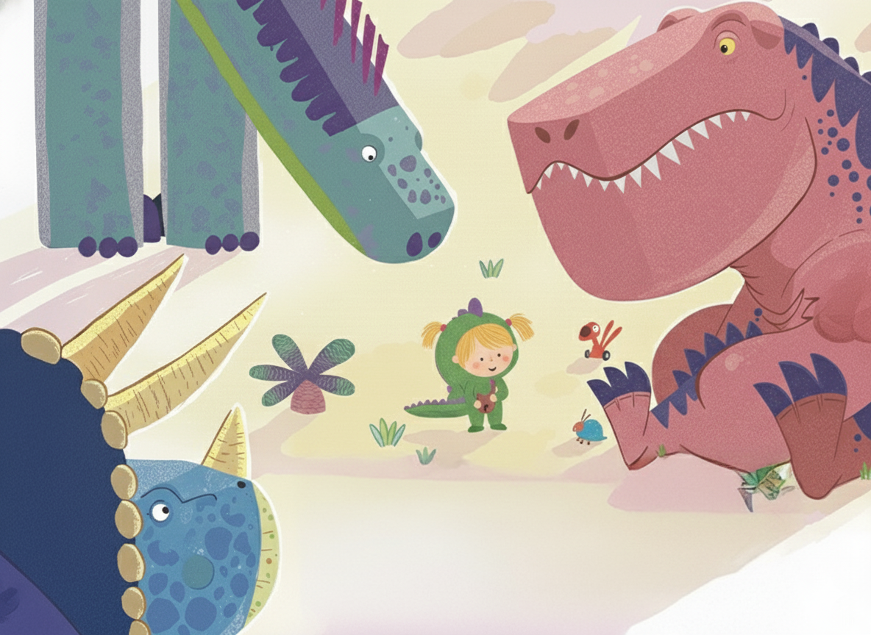
Then, from behind her, a voice rumbles, "No!
You mustn't believe that. It's really not so!
You should be proud of the things you can do
And we have exactly the right name for you!"

Slide 33
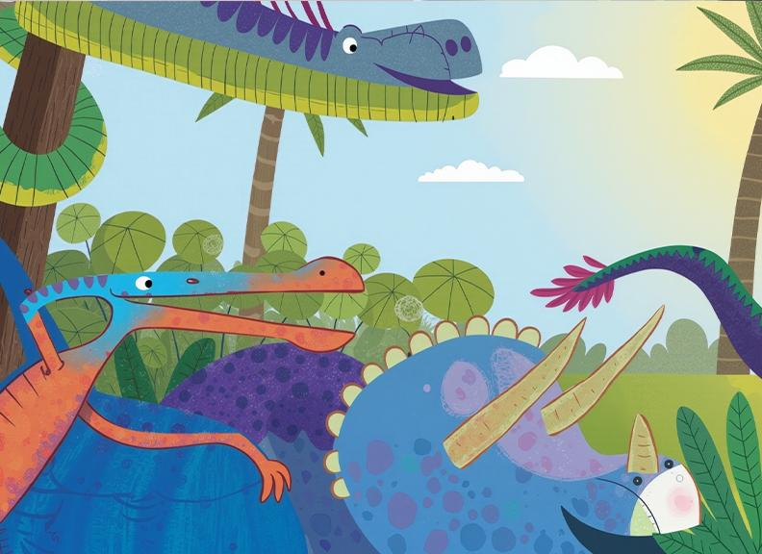
"YOU’RE A {{CHILD_NAME}}

Slide 34
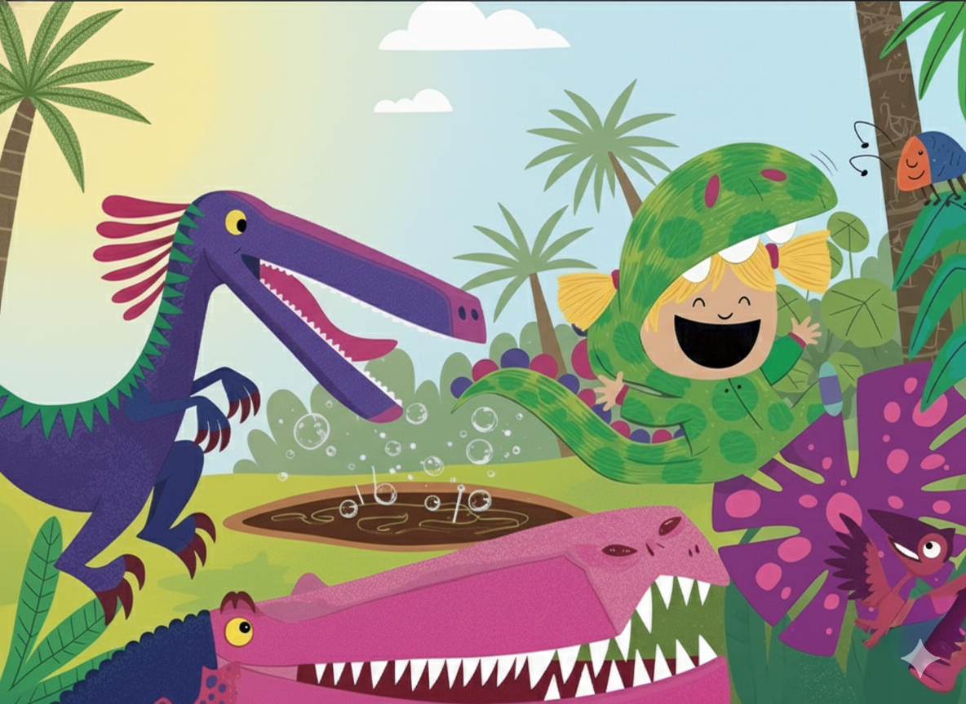
-O-SAURUS!"

Slide 35
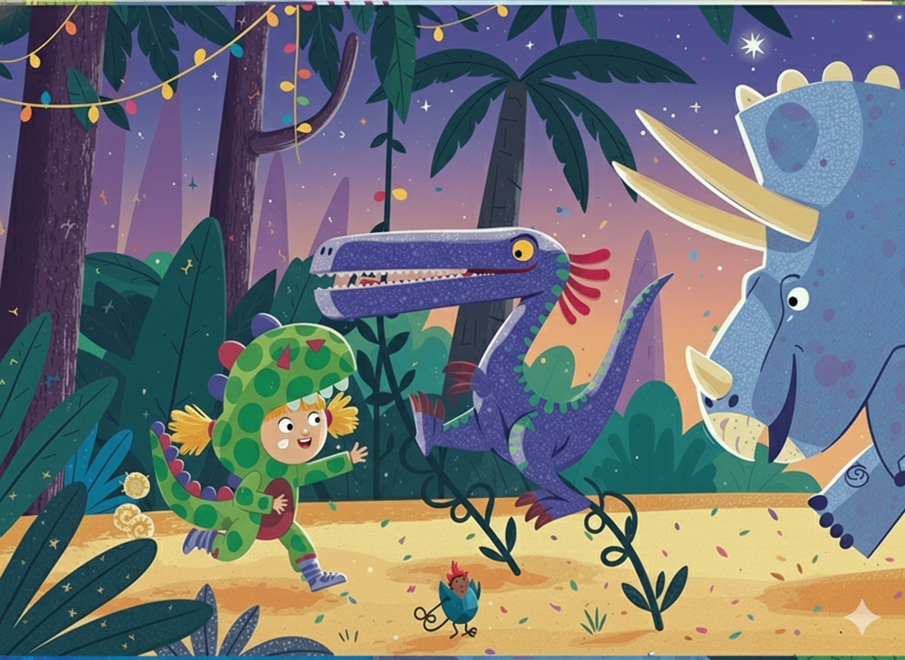
With {{CHILD_NAME}} in the lead, the dinosaurs dash, They trample and batter and clatter and crash, They flap and they roar, they gallop and prance - Yes, {{CHILD_NAME}} has taught all the dinos to DANCE!

Slide 36
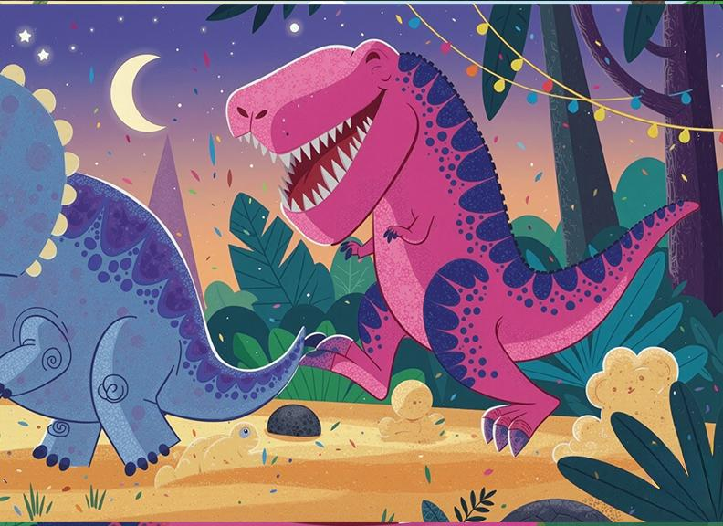

Slide 37
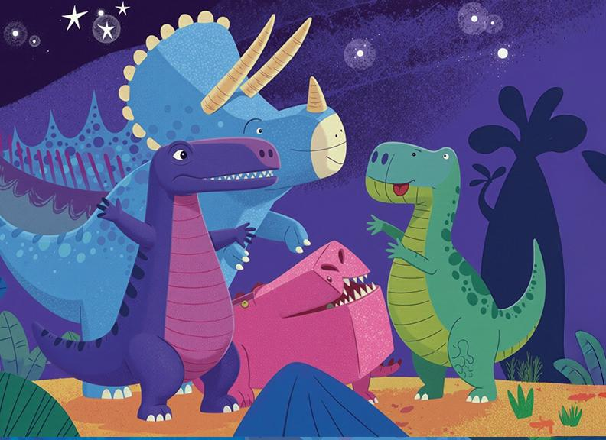

Slide 38
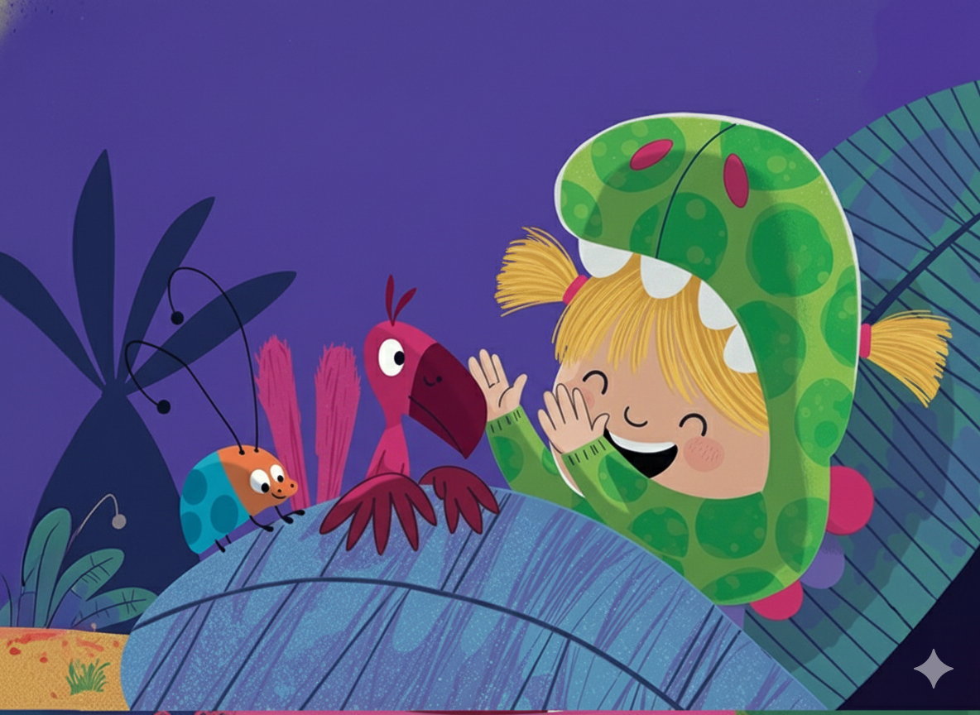
At the end of the dance they collapse in a heap.
They turn to thank {{CHILD_NAME}} ...
But she's fallen asleep.

Slide 39
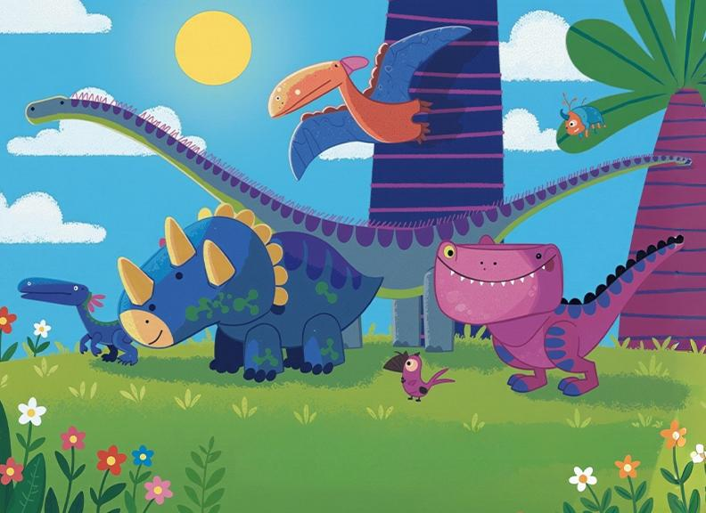

Slide 40
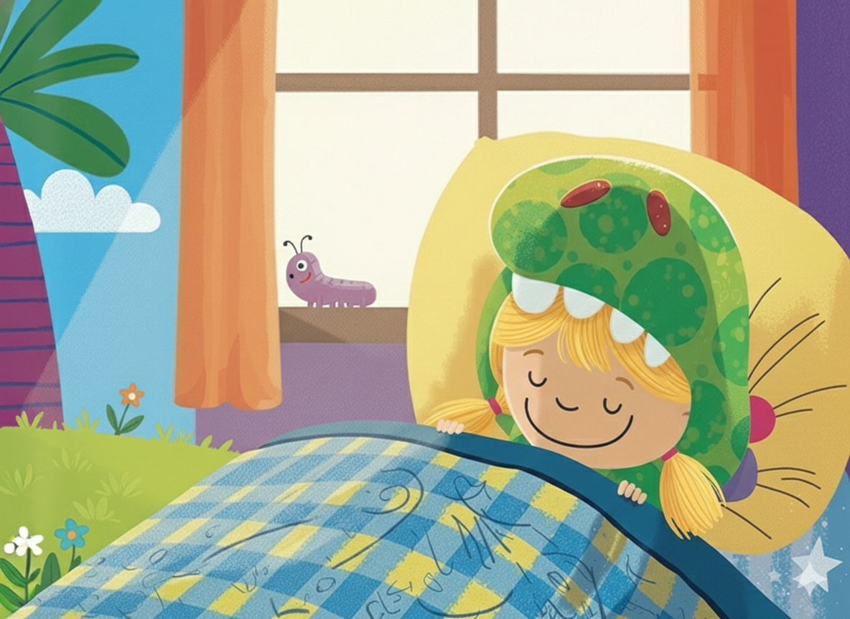

Slide 41
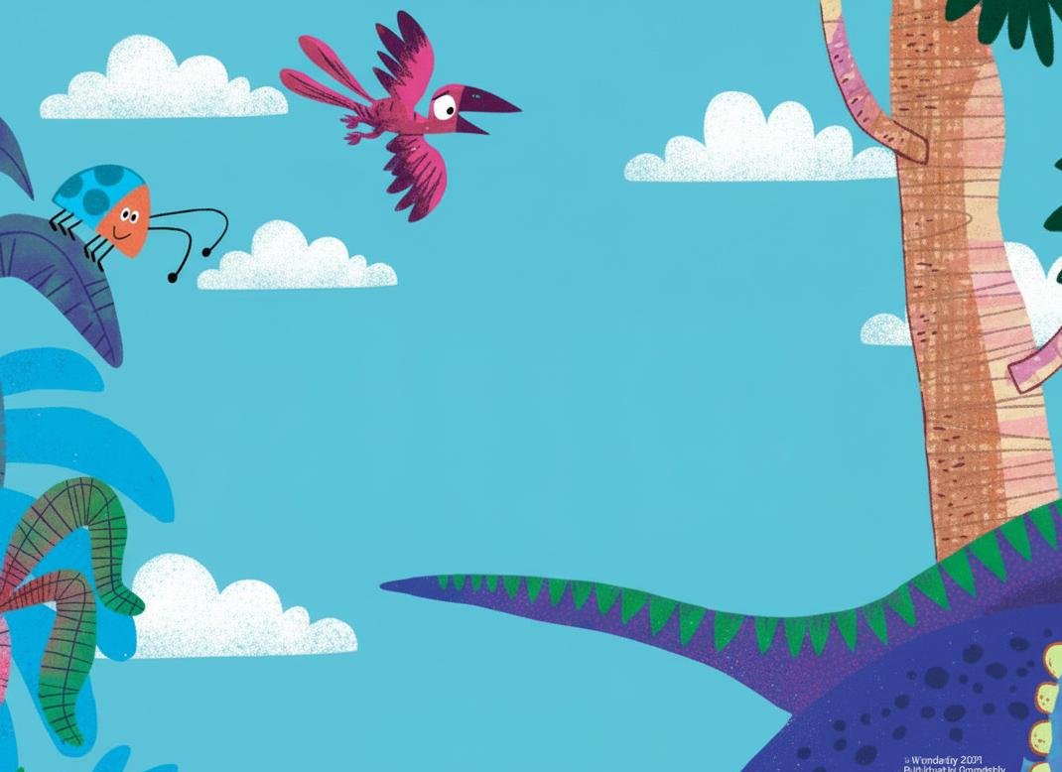
What's this? A noise wakes {{CHILD_NAME}} up in the night.
She looks all around, and hears with delight A monstrous, hair-raising hullabaloo...
She's in Dino Land - her dream has come true!

